Slide 1
Klasifikacija zdravlja fetusa na temelju kardiotokografije
Valentina Križ, Jelena Kurilić, Lucija Valentić
PMF – MO
Strojno učenje
2018./2019.

Slide 2
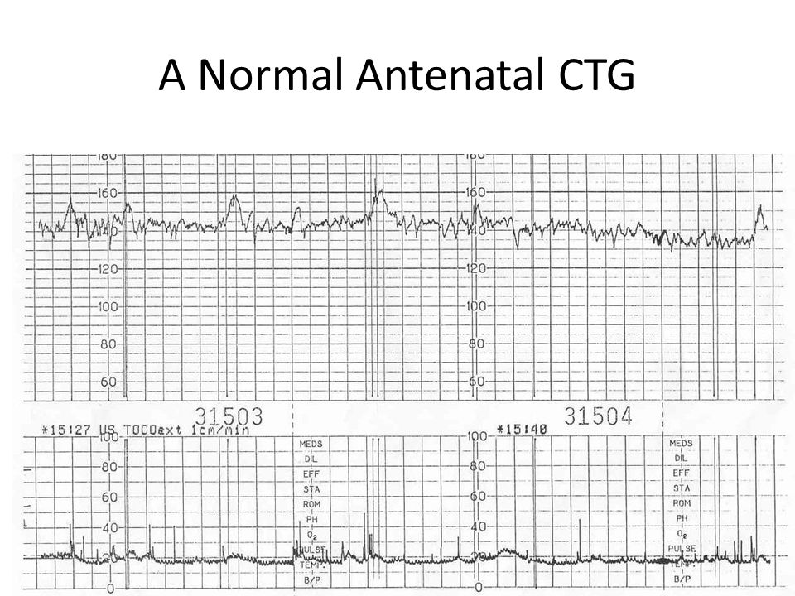
Uvod
Problem fetalne patnje
Kardiotokografija
Aktivnost srca fetusa
Kontrakcije maternice

Slide 3
Podaci
Cardiotocography data set iz UCI repozitorija za strojno učenje
2126 primjeraka
21 obilježje
npr. broj otkucaja u minuti, broj pomaka fetusa u sekundi, broj kontrakcija maternice u sekundi
3 klase:
Normalna
Sumnjiva
Patološka

Slide 4
Pregled literature
Korištene metode:
Diskriminantna analiza, stabla odlučivanja, neuronske mreže, metoda potpornih vektora, metoda najbližih susjeda, slučajne šume…
Najbolji rezultati:
Metoda slučajnih šuma - točnost 99.18%
Metoda najbližih susjeda - točnost 98.4%

Slide 5
Naš plan
Problem: nebalansiranost podataka
Zanemareno u svim radovima
Posvetiti se problemu nebalansiranosti podataka
Isprobati neke od metoda pomoću kojih su dobiveni najbolji rezultati

Slide 6
Literatura
M.-L. Huang and Y.-Y. Hsu, "Fetal distress prediction using discriminant analysis, decision tree, and artificial neural network," Journal of Biomedical Science and Engineering, vol. 5, p. 526, 2012.
C. Sundar, et al., "Classification of cardiotocogram data using neural network based machine learning technique," International Journal of Computer Applications, vol. 47, 2012.
E. Yılmaz and Ç. Kılıkçıer, "Determination of fetal state from cardiotocogram using LS-SVM with particle swarm optimization and binary decision tree," Computational and mathematical methods in medicine, vol. 2013, 2013.
H. Ocak and H. M. Ertunc, "Prediction of fetal state from the cardiotocogram recordings using adaptive neuro-fuzzy inference systems," Neural Computing and Applications, vol. 23, pp. 1583-1589., 2013.

Slide 7
Literatura
E. M. Karabulut and T. Ibrikci, "Analysis of cardiotocogram data for fetal distress determination by decision tree based adaptive boosting approach," Journal of Computer and Communications, vol. 2, p. 32, 2014.
H. Sahin and A. Subasi, "Classification of the cardiotocogram data for anticipation of fetal risks using machine learning techniques," Applied Soft Computing, vol. 33, pp. 231-238, 2015.
Z. Cömert, et al., "Cardiotocography signals with artificial neural network and extreme learning machine," in Signal Processing and Communication Application Conference (SIU), 2016 24th, 2016, pp. 1493-1496.
M. Arif, "Classification of cardiotocograms using random forest classifier and selection of important features from cardiotocogram signal," Biomaterials and Biomechanics in Bioengineering, vol. 2, pp. 173-183, 2015.
R. Kamath and R. Kamat, "Modeling fetal morphologic patterns through cardiotocography data: Decision tree-based approach," Journal of Pharmacy Research| Vol, vol. 12, p. 10, 2018.

